Slide 1

Image- Based Skin Cancer Detection
User Manual
Author: Veer Duggal
Notes:
Preworks course home assignments

Slide 2
Table of Contents
Acknowledgement
About me
About my Internship Journey with Clevered
About the Application
How to use the application
Contact

Slide 3
Acknowledgements
I would like to thank my parents, my mentor- Avishek Das sir, Mr. Ken, and all my friends for supporting me throughout the course of this journey

Slide 4
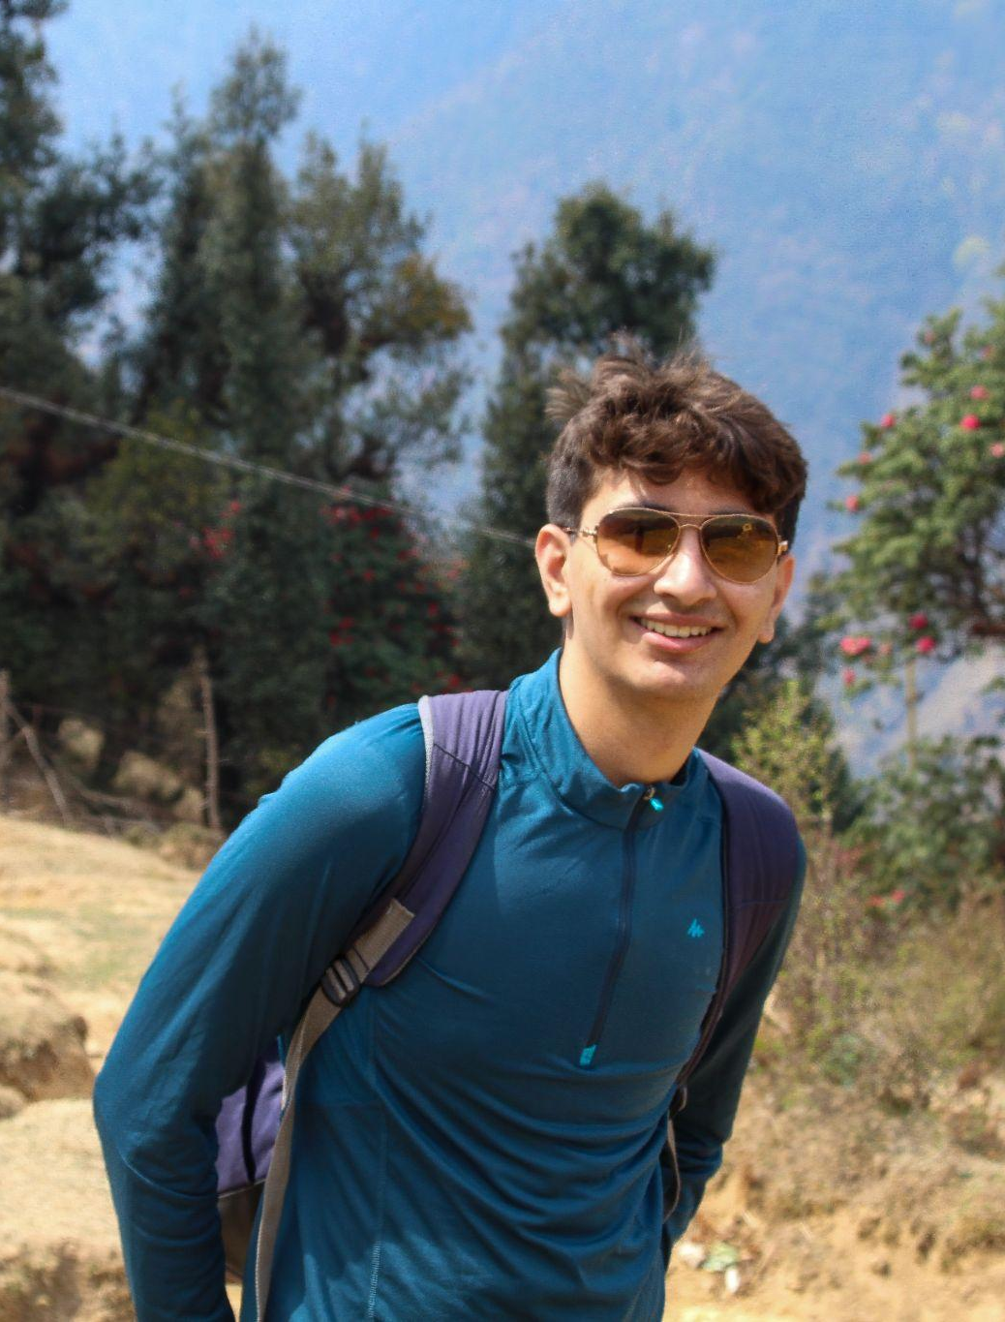
About Me..
Hi! My name is Veer Duggal, I’m currently studying in the 11th grade in the Doon School Dehradun under the ISC curriculum.

Slide 5
About My Internship Journey with Clevered
I learned python using Google Colab, and had really fun in doing so. Making various projects and learning a lot of specifics of the code

Slide 6
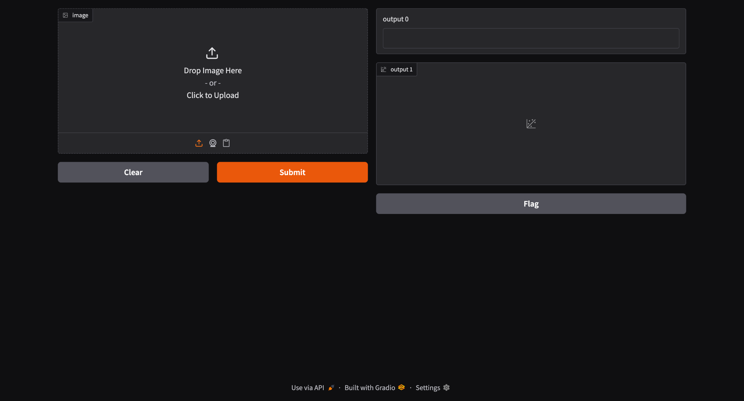
About The App
Image based Skin cancer detection system- An app that lets the user upload an image to it and figure out what type of skin cancer it is

Slide 7
How do I use the App?

Slide 8
App Screen 1

Slide 9
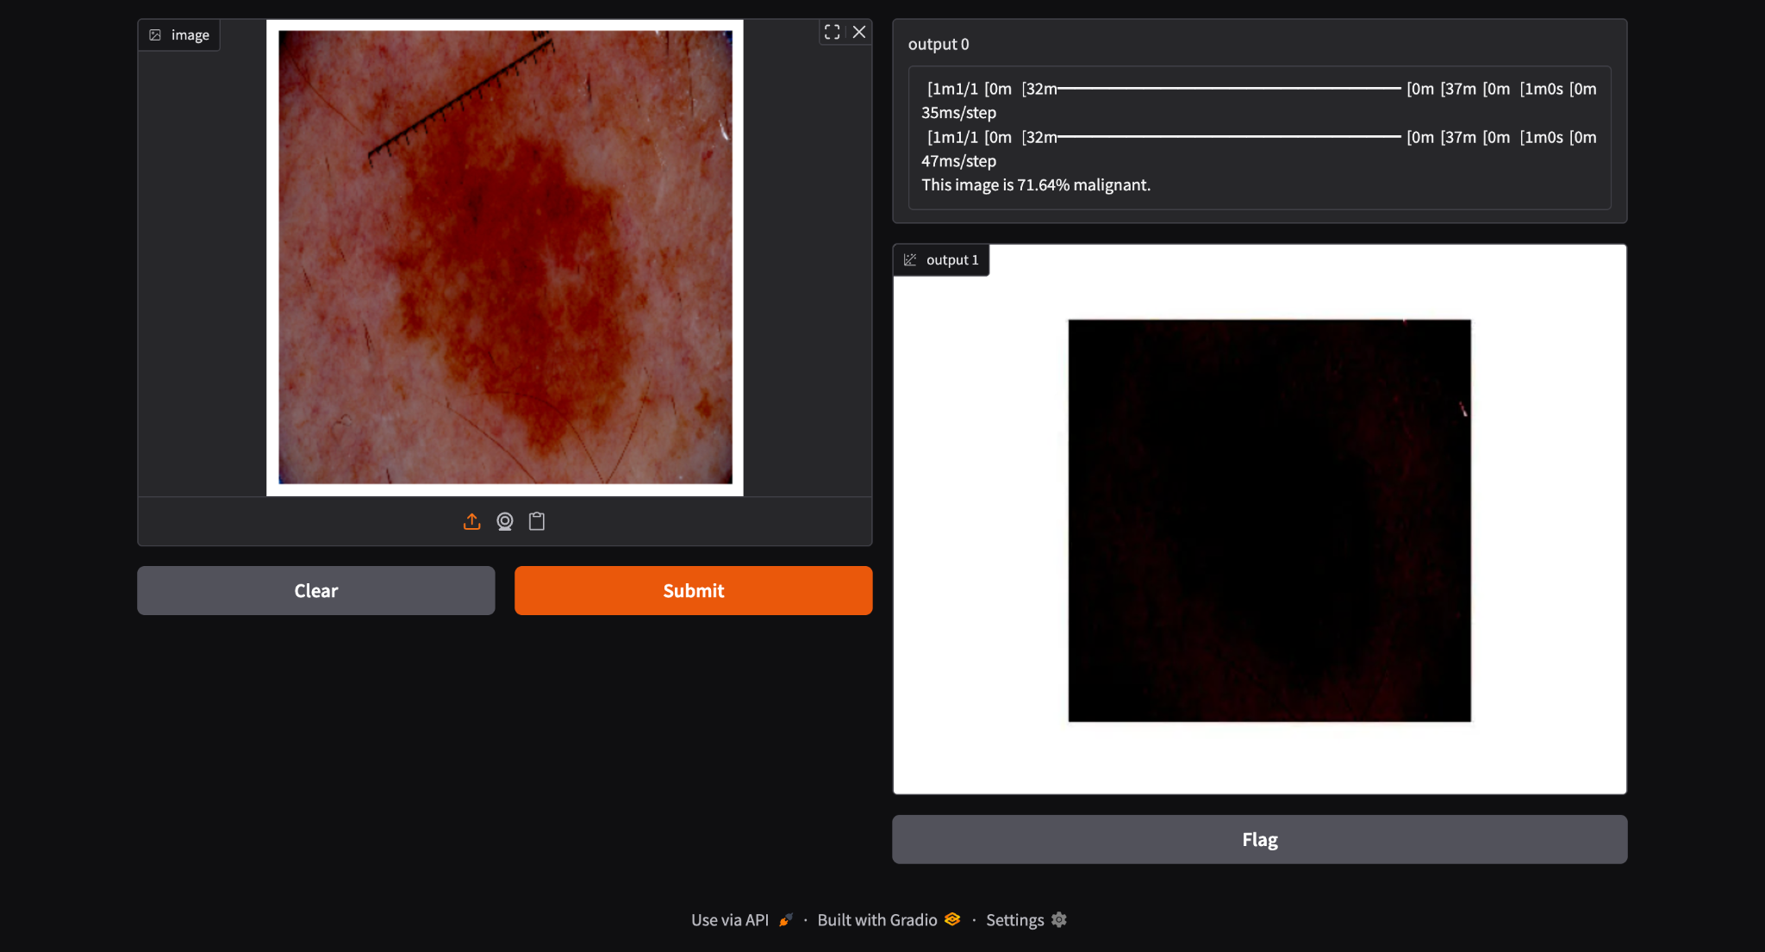
App Screen 2

Slide 10
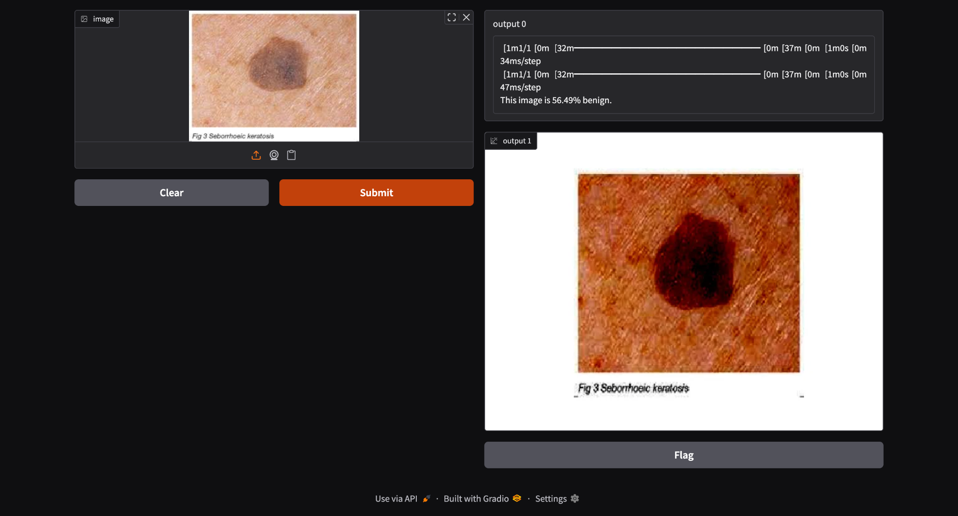
App Screen 3

Slide 11
Contact Person
Please reach out to Veer Duggal at veersinghduggal@gmail.com for any questions/ concerns/ suggestions on the App

Slide 12
Thank you!

